Slide 1
FUNdraising
as an AmeriCorps VISTA

Slide 2
Objective
Understand concepts of fundraising in the nonprofit sector. Come away from today knowing the following:
Different types of fundraising
Goal setting
Provide solutions to problems
Utilize resources in your community
Learn new resources
Fundraising is a team sport!
You don’t have to be great at every little thing

Slide 3
Grant Writing, Development, Communications...
Grant Writing: is the practice of completing an application process for a financial grant provided by an institution
Development: raise funds for various philanthropic efforts
Communications: any communication that takes place between a nonprofit and its audience - includes solicitations, thanks you notes, updates, etc.
Everything is related and works best when working together. But, these 3 categories are not the same.

Slide 4
What Are Your Goals?
Problems → Solutions
Refer to Your VAD:
Does your organization lack visibility?
How does fundraising help that problem?
Does your organization need new equipment?
How does fundraising help that problem?
Does your organization need to increase membership?
How does fundraising help that problem?

Slide 5
Donor Centric vs. Community Centric
Let’s do some research.
Community Centric Fundraising
https://communitycentricfundraising.org
Other schools of thought: Donor Centric
No matter what: Communication is key!
Most organizations are going to be donor centric. That’s ok! For a long time donors have been the focus. But challenge your thought process. What are the benefits?

Slide 6
Facts of Fundraising
Online Fundraising is Increasing*
Up 20% in the last year
Demographics of Donors are Changing
https://nonprofitssource.com/online-giving-statistics/demographics/
The average gift made online is $177*
*https://philanthropynewsdigest.org/news/online-giving-up-more-than-20-percent-in-2020-report-finds

Slide 7
Types of Fundraising
Monetary
Online
Website
Social Media
Days of Giving
Direct Mail
Events
Direct Ask- from who?
Non-Monetary (What’s that?!)
Volunteers
Board members
Services
Supplies

Slide 8
Where Do I Start?
Your own site!
Do you have development staff?
Is your site a member of…
Kentucky Nonprofit Network www.kynonprofits.org
Center for Nonprofit Excellence www.cnpe.org
Start signing up for free trainings and seeing what’s available (will your site pay for training?)
Refer back to your VAD (again) and site’s goals. What are you working towards?
Write down a timeline of goals
In the meantime...

Slide 9
Where Do I Start? - Social Media
A Few Steps:
Define your message
What problem are you trying to solve?
What solution do you provide?
What’s the resulting impact?
How can people help?
Define your goals
What does social media success look like? More followers? More donors? Write it down!
Define your audience
Describe 3 characteristics of your target audience.
Why is this important?
jcsocialmarketing.com

Slide 10
Where Do I Start? - Storytelling
How?
Elevator speech
You know this!
Volunteers working with your site & clients
Staff
Clients*
What are some challenges you may face?
“Poverty porn”
Unequal power dynamic
Uninformed consent
jcsocialmarketing.com

Slide 11
Where Do I Start? - Storytelling
Tips:
Are 1.5-2 minutes spoken
Cite sources
Provide background info: set the scene. What’s it look like, smell like, taste like, etc.
Presents challenges but ALSO shares successes
Alternative:
6 word stories with pictures! Challenging but effective.
Speaking of pictures…
www.Canva.com
results.org

Slide 12
Where Do I Start? - Events
Types of Events:
Large
Medium
Small
But really…
Annual events with returning audiences
Community events
Info events
How many is too many?
What’s most important at each of these events? Your ability to connect, “sell”, tell stories- that’s what matters. Do other things help? Sure.

Slide 13
Where Do I Start? - Events
So, what other things help?
Planning
Set a budget & a goal
Sponsors? Donations? Thank Yous?
Flyers
Different events are probably going to require different flyers (info vs. black tie gala)
Sign up sheets: collect email/mailing addresses!
Swag: whatever that may be! Cheap (candy) to not cheap (anything with a logo)
Thank You Notes/Cards: include tax ID #
What’s most important at each of these events? Your ability to connect, “sell”, tell stories- that’s what matters. Do other things help? Sure.

Slide 14
Where Do I Start? - Online Day of Giving
Tips:
Planning
You know the dates far in advance. Get ready!
Promotion
Have some graphics ready to go. Schedule them.
Board Involvement
Ask the board to share with their networks
Go to them & take their picture with a quote about why they give
Thank You Notes/Cards: personalize your thank you for this day

Slide 15
Where Do I Start? - Volunteer Recruitment
Volunteers are people! Remember their needs (and yours, too).
What are your volunteer needs?
One time vs. ongoing
What type of volunteer are you looking for?
This may determine where you recruit
Recruitment
Use what you already have: social media, direct mail, email, board of directors, donors, business contacts, school groups
Do not forget the power of a thank you. How big does it need to be?

Slide 16
Where Do I Start? - Direct Mail
Plan!
Define your audience
Are you using acronyms? Might be ok, but...
Define your message
Be clear & concise: define your problem and propose your solution
Graphic Design 101
If nothing else, Canva!
You get ads/flyers in the mail everyday. What are the ones that catch your eye?
Do not forget the power of a thank you. How big does it need to be?

Slide 17
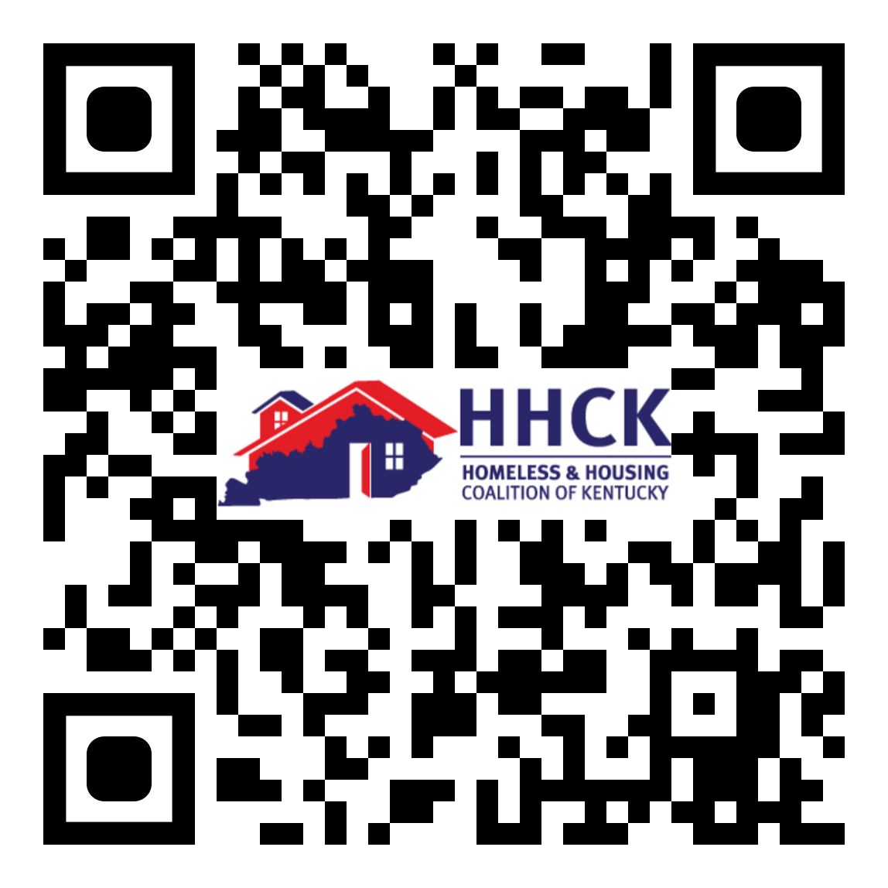
Resources
Find What Works Best For You, But Here Are a Few:
www.Canva.com
Canva Pro is free for nonprofits after application
Mailchimp, others
Affordable direct email
TinyURL
Shortens long web addresses BUT does not give you any data on clicks.
Bitly
Shortens long web addresses AND gives you data on clicks (but it isn’t free)
QR Codes:
There are a lot of free ones out there BUT beware: some are only free for a limited time

Slide 18
Questions?

