Slide 1
Implementing Case Management Tools in Direct Service
Kim Hollingsworth
Senior Housing Specialist
HHCK

Slide 2
Agenda
Overview of Housing Focused Case Management
Structure of home visits (setting boundaries, expectations, and time frame, and goals)
Scheduling home visits based on acuity
Implementing the housing focused tools
Documentation and Organization
Final tips
Self-Care

Slide 3
About Me
Grew up in Lewis County (northeastern Kentucky)
Mom and wife (Emily, 20, Emerson, 13, Carter, 10)
Former teacher/librarian
Graduated from Morehead State University with BA in Education and the University of Kentucky with a MS in Library Science
Currently a student at the University of the Cumberlands working toward a MA in Clinical Mental Health Counseling
Live in Lexington, KY
Former AmeriCorps member and current Senior Housing Specialist at HHCK

Slide 4
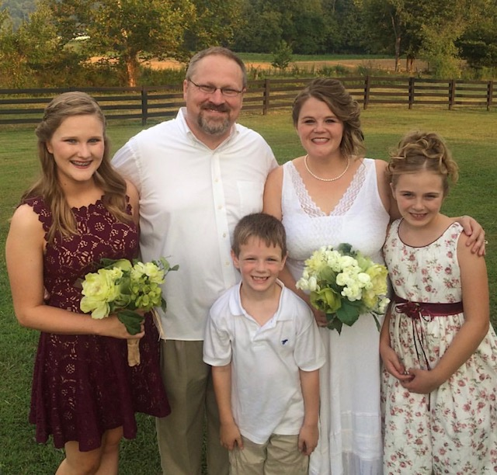
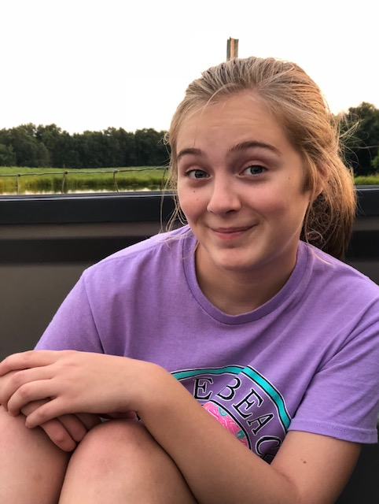
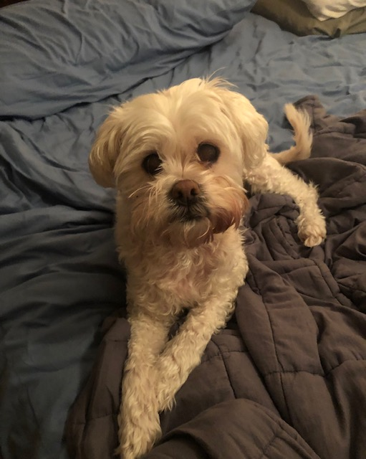

Slide 5
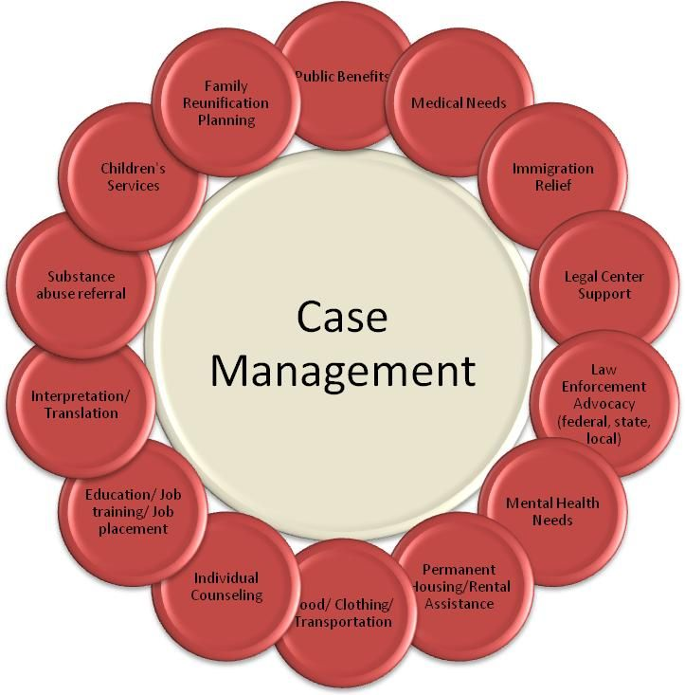

Slide 6
Roles of Case Managers
Assess needs
Set the time frame and expectations up front
Develop Individual Service Plan’s (ISP) based on specific goals
Connect clients to community resources
Food bank/Emergency food pantries
Counseling Services
Primary care doctor
Volunteer work, Job training, or employment
SNAP benefits
Provide structure and support
Advocate on behalf of clients
Stay client driven
Use a strengths based perspective

Slide 7
Housing Focused Case Management

Slide 8
Housing Focused Case Management
Main Role: Assist and support clients in achieving long-term success in housing
Focus on housing stability prior to establishing goals
Reduce the likelihood of returning to homelessness
Implement housing focused tools (ex: crisis plan, guest policy)
Review expectations of the lease and occupancy agreement
Meet individuals in their home
Be organized and have a plan for each home visit
Notes:
Explain importance of reviewing the lease and occupancy agreement because there are situation in which someone who has been chronically homeless may desire to help other who are in the same situation and allow them to stay over long term, which is a violation of the occupancy agreement and their landlords guest policy

Slide 9
Overall Structure
Plan amount of home visits per month based on acuity/need
Document every home visit and interaction with clients, whether it’s a home visit, office appointment, or a phone call
Have an individual case management file for each client
Provide clients with a folder to keep case management tools and documents
Always remind clients to update you about changes to contact information, new phone number, email, mailing address, etc.

Slide 10
Organize home visits based on acuity
Notes:
Talk about organize home visit by county as well

Slide 11
Structure – First Home Visit
Introduce yourself and explain what you do
Eliminate distractions (TV, radio, pets, guests) and set expectations up front
Discuss confidentiality
Explain your role and set boundaries
Make sure client has your contact information and you have theirs

Slide 12
Structure - Ongoing home visits:
Always start by reminding clients about the time frame and plan for the home visit
Outline objectives (no more than 3)
Execute plan (housing focused tools, job applications, disability income applications, budgeting, grocery shopping, discuss lease violations, create action plan, etc)
Ask probing questions to stay on track and avoid idle chit-chat
Remember to track progress and show clients, no matter how small or big

Slide 13
End of home visit
Summarize what was discussed and completed during the home visit
Establish objectives for the next visit and have client write them down
Schedule next home visit
Acknowledge something positive

Slide 14
Setting Boundaries
Do:
Do not:
Define your role, explain what you can and cannot assist with
Be specific about hours of contact: Monday through Friday 9:00am to 4:30pm
Dress appropriately, especially shoes
Address inappropriate remarks from clients
Say “call me anytime you need help with something”
Give out personal phone number
Accept gifts from clients
Respond to client outside of established work hours
Friend clients on social media
Notes:
Example: you can take a client grocery shopping to help with budgeting food stamps, you won’t go to the store for them. You can take them to get a money order or pay utilities, you won’t do it for them. You can call to schedule a counseling or doctor’s appointment with someone, not for them. Let clients know to leave voicemails and wait until you return their call. Inappropriate remarks: racial slurs, inappropriate compliments, threats

Slide 15
OrgCode’s Housing Focused Tools
Crisis Plan – 1st home visit
Guest Policy – 1st home visit
Honest Monthly Budget – 2nd home visit
Week of Meaningful Activities – 2nd home visit
Risk Assessment – 3th home visit
Support in Domains – 4th home visit
Individual Service Plan (ISP) – ongoing
Readiness ruler – ongoing with ISP
Quality of Life Survey – 6th months after lease up
Exit Planning
Notes:
Talk about developing a work flow

Slide 16
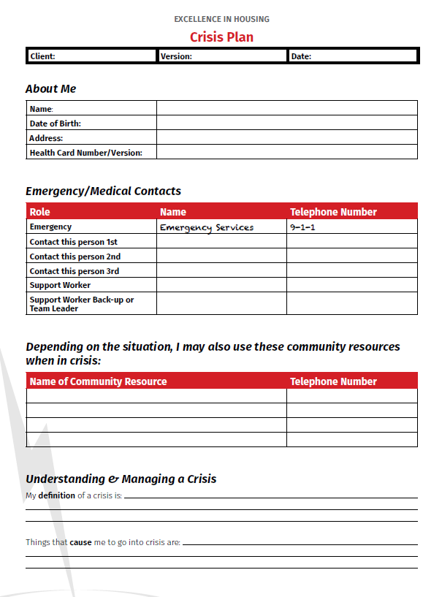
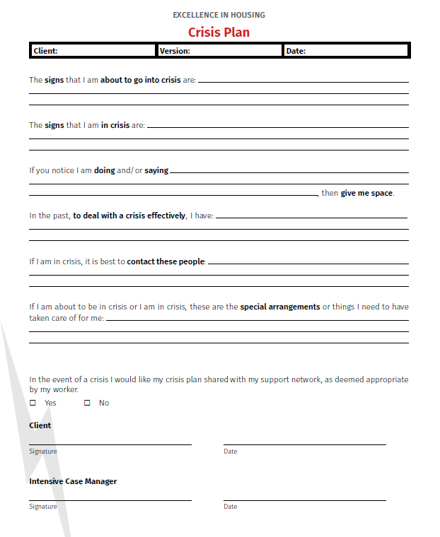

Slide 17
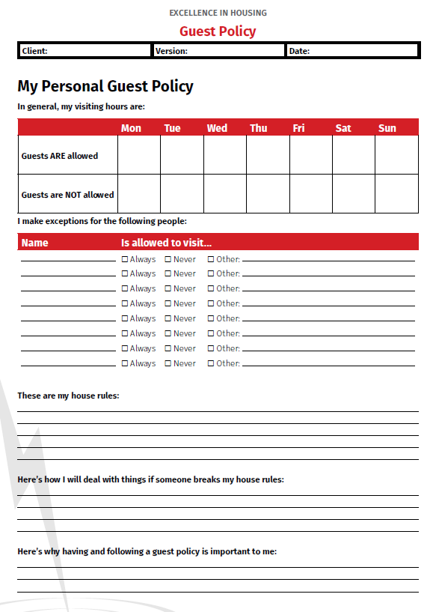

Slide 18
Additional Questions
If someone brings a friend over that you don’t know, is that alright with you?
Who is responsible for guest damages?
Are there any activities you do not want happening in your apartment?
If guests get in a fight, how will you respond?
Are you ok with people eating your food and using your belongings?
What will you do to make sure there are no noise complaints?

Slide 19
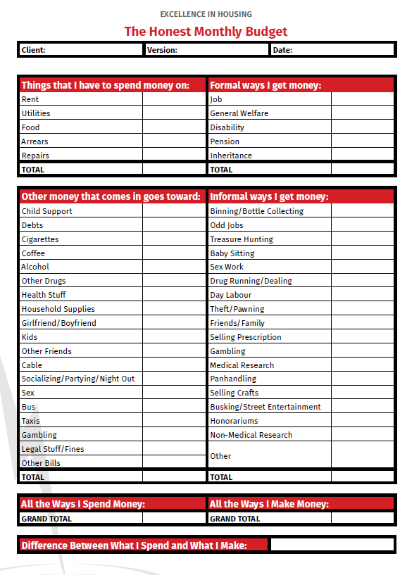

Slide 20
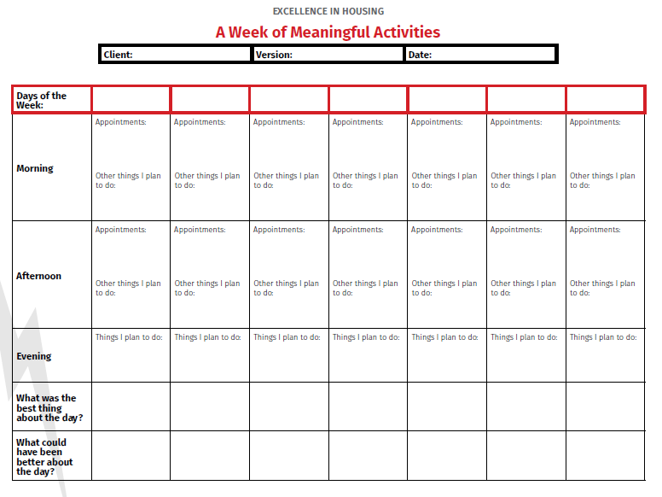

Slide 21
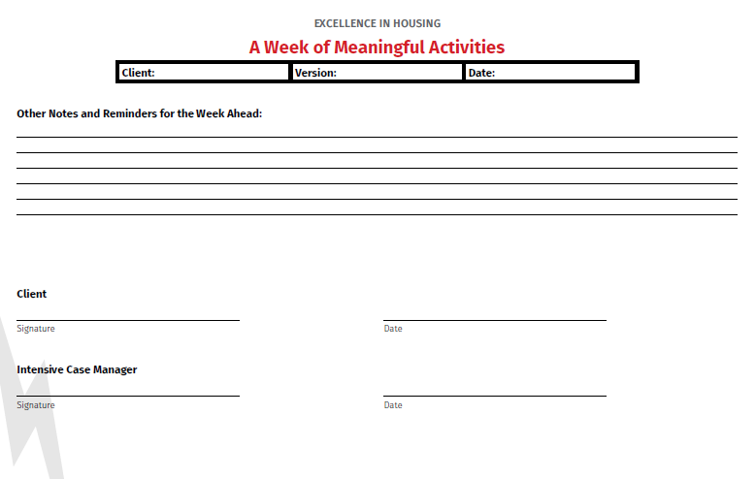

Slide 22
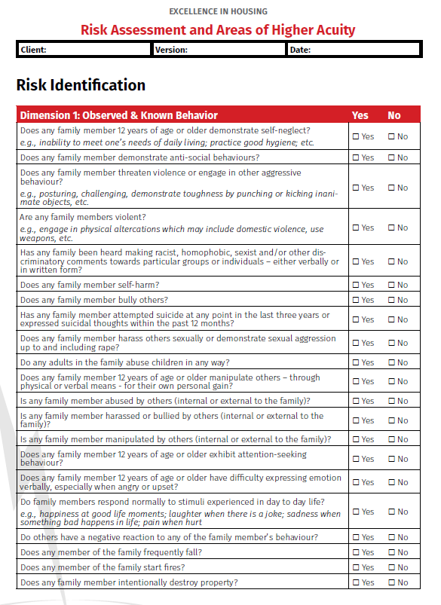
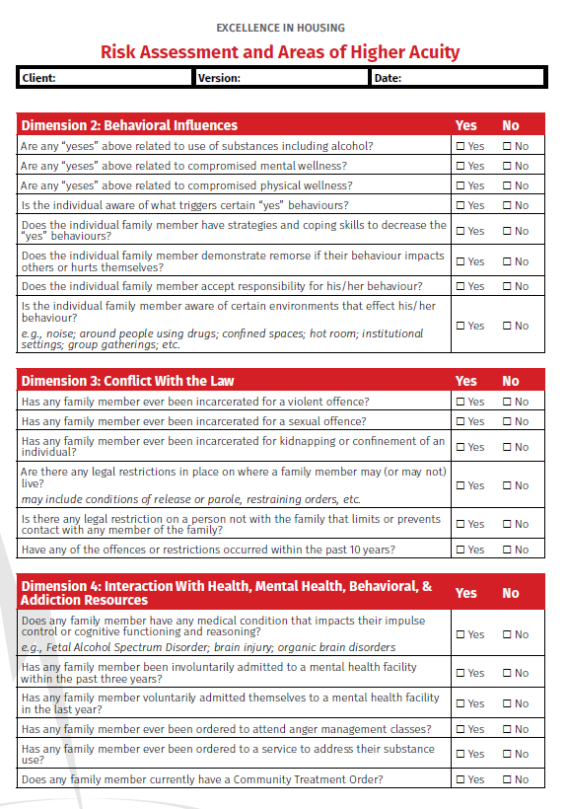

Slide 23
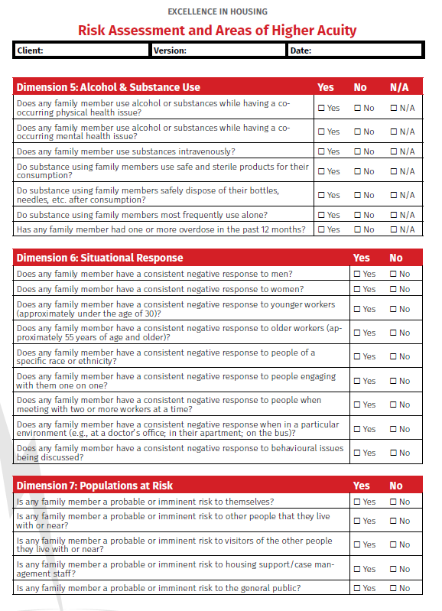

Slide 24
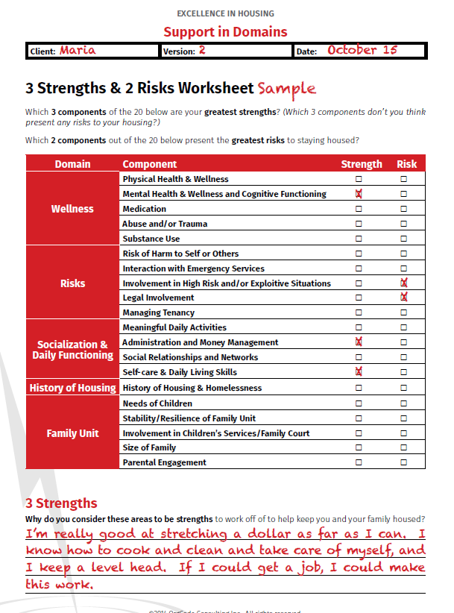
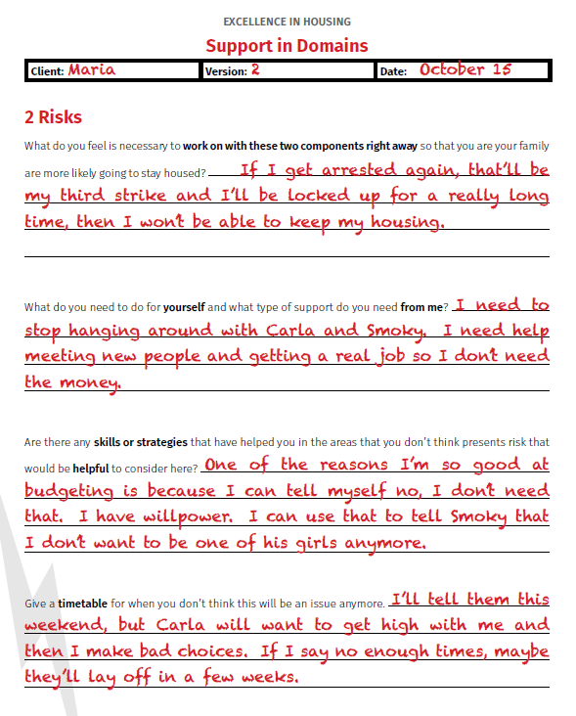

Slide 25
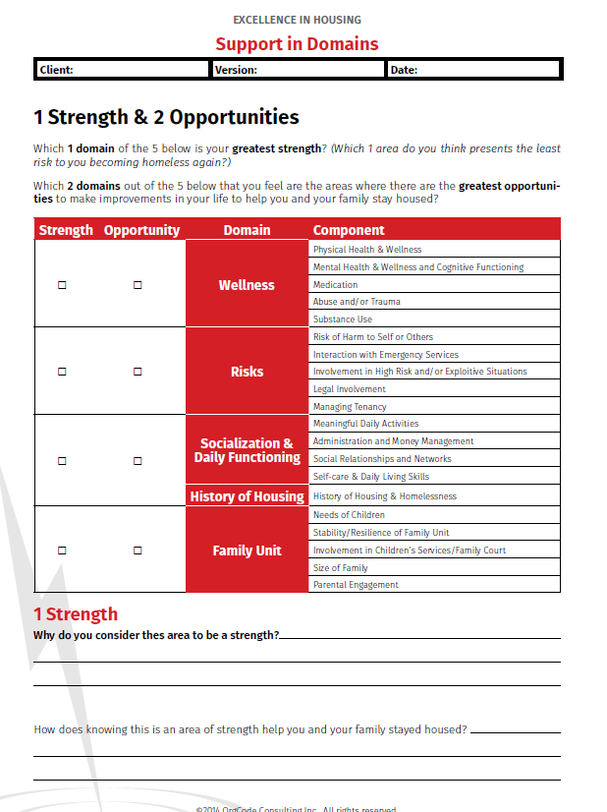
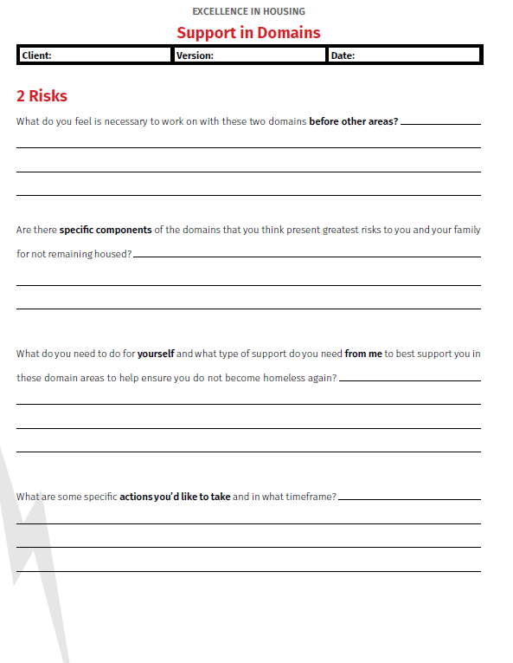

Slide 26
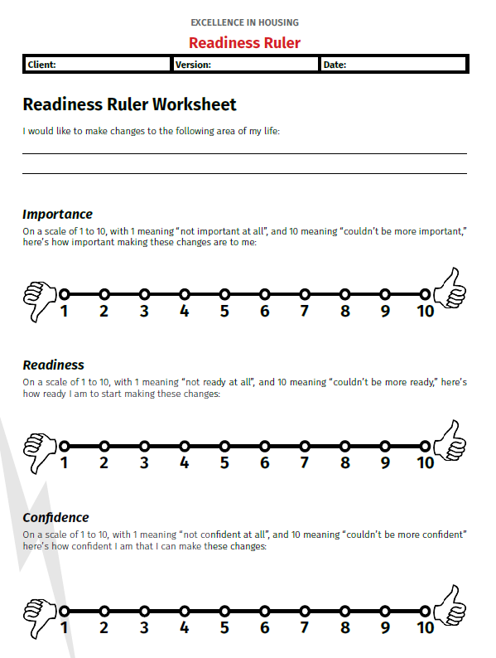

Slide 27
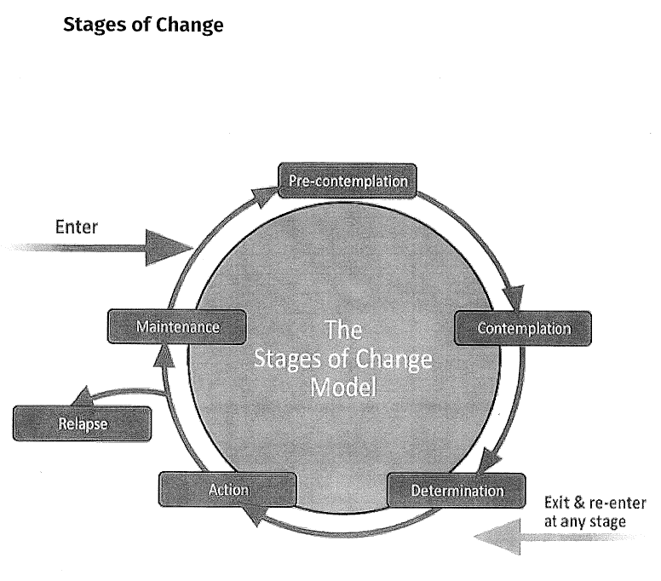

Slide 28
Ask the important questions
Why did you mark yourself there?
Why didn’t you mark yourself higher?
Why did you not mark yourself lower?
What is preventing you from being more towards a 10?
Is there anything we can set up that will help you take the next step?
What helped you get all the way to 10?
How do you feel now that you are at 10?

Slide 29
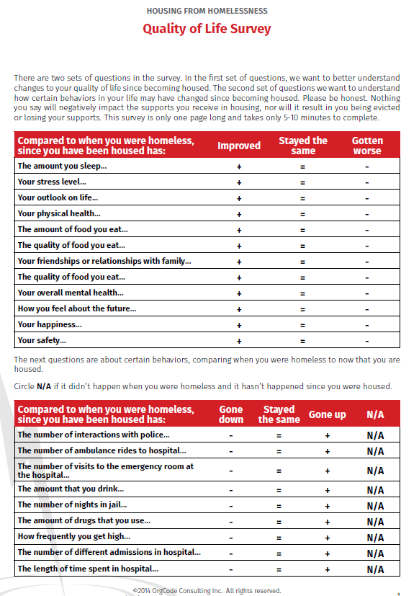

Slide 30
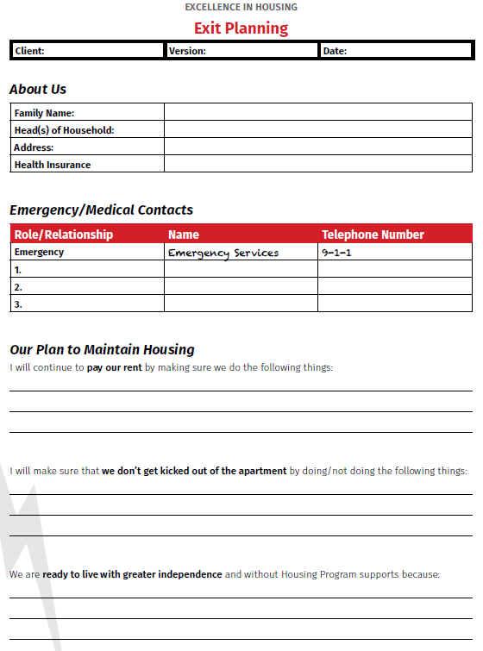
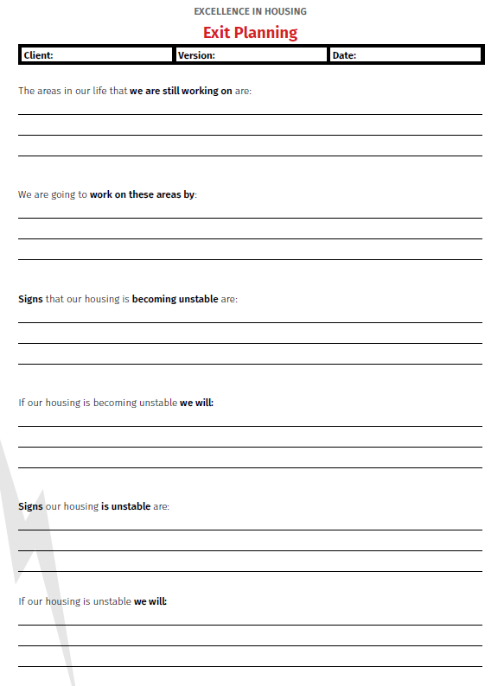

Slide 31
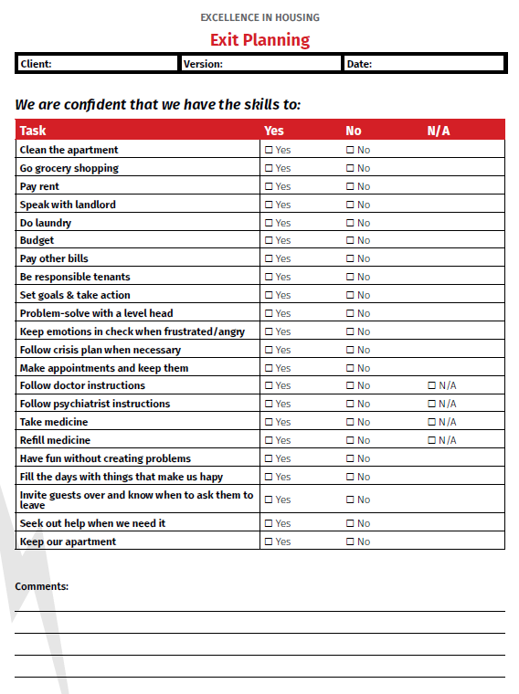
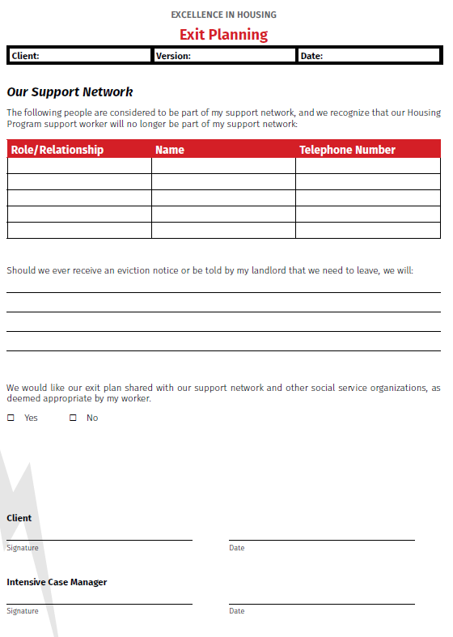

Slide 32
Documentation & Organization

Slide 33
Organization
Have an individual case management file for each client
Provide each client with a folder, binder, file, etc. to organize important documents and tools they have completed during home visits
Make sure clients have a way to keep track of home visits: (ex: wall calendar, phone calendar, marker board, post it notes)
Keep a spreadsheet with contact information and update regularly

Slide 34
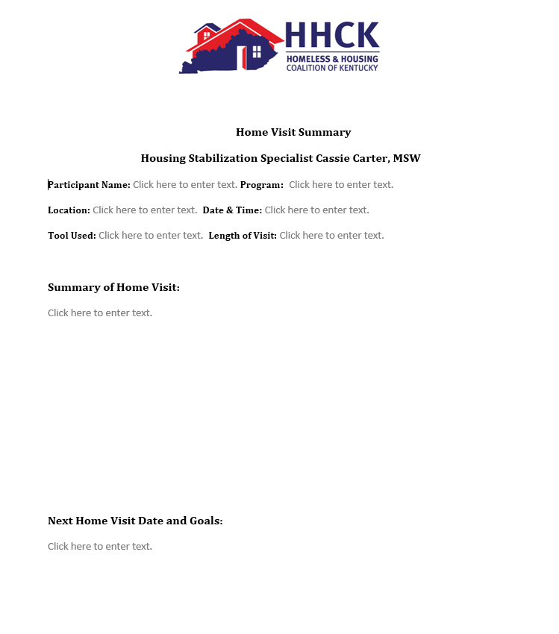
Documentation

Slide 35
Documentation

Slide 36
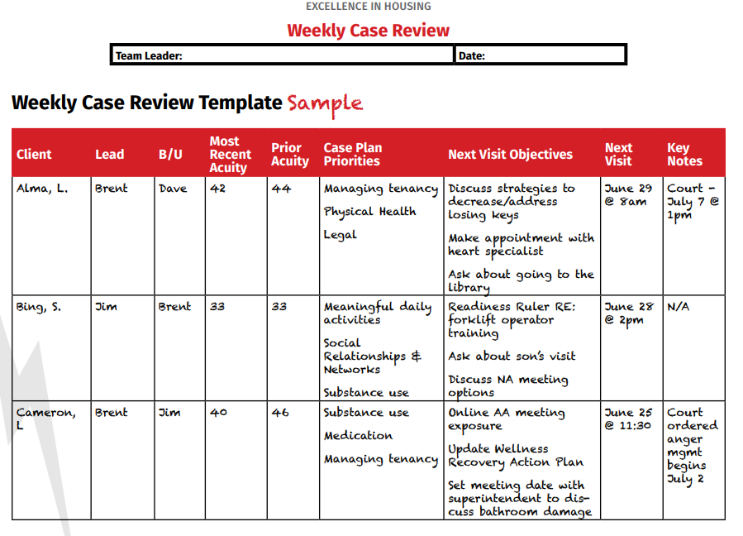
Documentation

Slide 37
Final Tips
Be flexible
Stay organized
Remind clients about home visits via call, text, email, or mail. (Model respect for your client’s time. Apologize if late, etc.)
Set boundaries
Communicate and use teamwork to problem solve difficult situations
Have templates saved for missed appointments and reminders
Make it a habit to update client contact info at each visit. (phone numbers)
Always schedule yourself a break

Slide 38
Compassion Fatigue and Vicarious Trauma

Slide 39
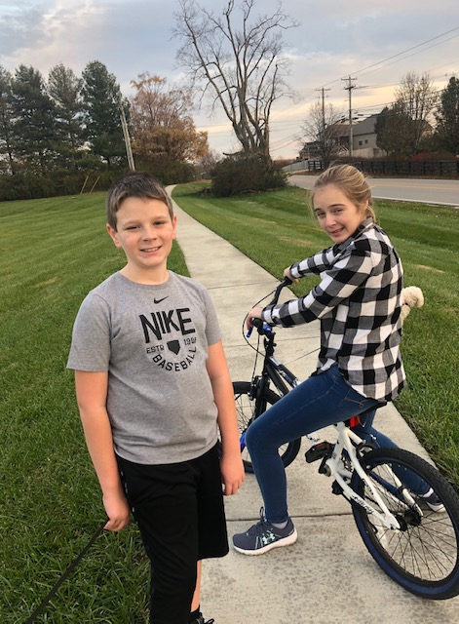
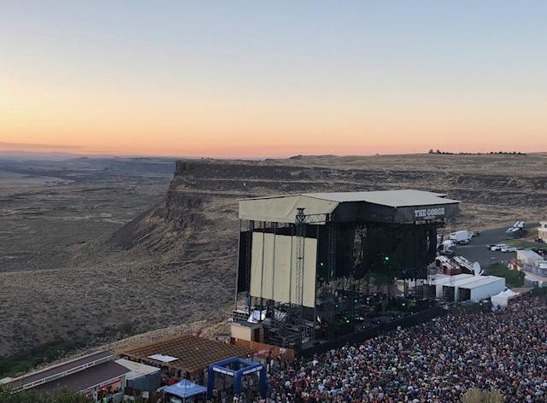
Practice Self-Care!

Slide 40
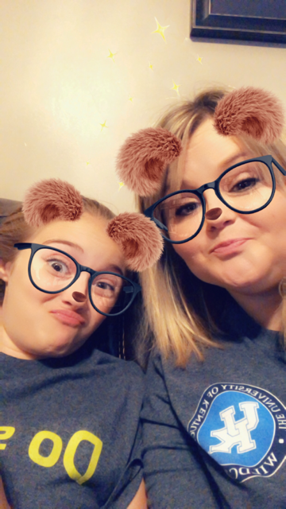
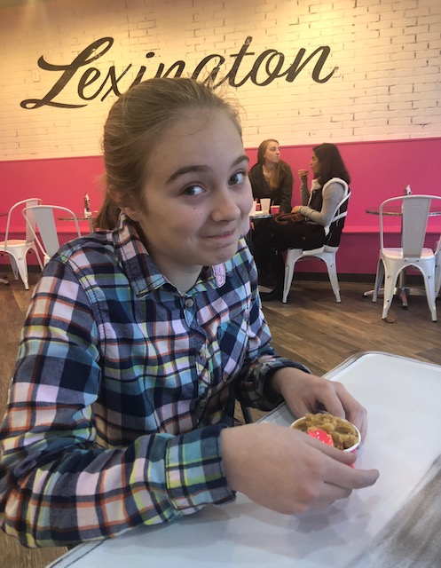
And more self care…

Slide 41
Thanks for Listening!
For Housing Focused Tools, you can find free downloads at:
http://www.orgcode.com/products

Slide 42
QUESTIONS?

