Slide 1
Housing Searches

Slide 2
HI, I’m JENNY Andrews! ☺
February 2020, I started as the Housing Navigator at HHCK
I served as an AmeriCorps Member for two years (2017-2019) at Gateway House in Morehead, KY
Born in Morehead, KY and recently moved to Versailles, KY with my husband, 2 dogs, husband‘s BFF & his dog and cat (we’re a big fam)
Graduated Morehead State University with a Bachelors in Psychology and Philosophy
I’ll be 26 next week!
I like to spend time with family + my dogs, play video games, decorate, watch reality TV (KUWTK, Big Brother), and travel

Slide 3
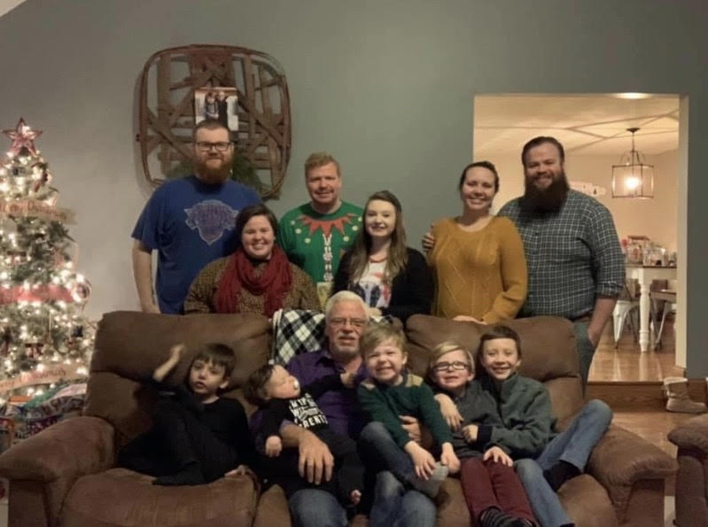

Slide 4
Housing Needs/Preferences
Identify Needs/Wants/Barriers
Downstairs unit (wheelchair/children)
Dishwasher (hands)
Bedroom size
Washer and Dryer vs. Laundry Mat
Public Transportation vs. Vehicle
Employment/Children’s Schools
Pets
Landlord Blacklist
Utilities
Evictions
Background checks
This will be specific to each client and will not be the same across the board
Client Centered

Slide 5
Fair Market Rent!!!!!
This is important because…
Programs (TBRA/RRH/PSH)
MOST IMPORTANT….needs to be able to sustain
Different for each county/look up a quick search of HUD FMR
https://www.huduser.gov/portal/datasets/fmr/fmrs/FY2020_code/select_Geography.odn
Look at their budget and make sure the client can afford! (without assistance)

Slide 6
Keep a log
Landlord/Property Manager
Price (is it in FMR??)
Are all/partial utilities Included
Bedroom Size
Address
Contact Information

Slide 7
Where do I start??
Landlords that your agency already has a relationship with
Newspaper
Zillow/Trulia/FB Marketplace (but be careful!)
Realtor Agencies
Field Search

Slide 8
Negotiation
Adapt to the landlord, but be honest
This is a great time to brag on your client in an honest way (employment, honesty, clean, etc)
Only what you know… you are not a reference
Its okay to get a “no”, may have not been the right fit
Sell those Programs (1st month’s rent, utility deposits, etc)
Utilities

Slide 9
Next Steps?
Application?
Viewing
make sure the client is able to get there (transportation and time)
Photos? Video?

Slide 10
You can do this.
There is a shortage of affordable housing everywhere, that’s why we need you!!!

Slide 11
Not your choice.
It’s the client’s.
Offer, and if it looks like it will be difficult to find another unit, be honest.

Slide 12
Discrimination??
Call Fair Housing Council:
859-971-8067

Slide 13
Questions?

Slide 14
THANK YOU!

