Slide 1
VI-SPDAT
By: Jenny Andrews

Slide 2
Hi, I’m Jenny ☺
February 2020, I started as the Housing Navigator at HHCK
I served as an AmeriCorps Member for two years (2017-2019) at Gateway House in Morehead, KY
Born in Morehead, KY and recently moved to Versailles, KY with my husband, 2 dogs, husband‘s BFF & his dog and cat (we’re a big fam)
Graduated Morehead State University with a Bachelors in Psychology and Philosophy
I’ll be 26 next week!
I like to spend time with family + my dogs, play video games, decorate, watch reality TV (KUWTK, Big Brother), and travel

Slide 3
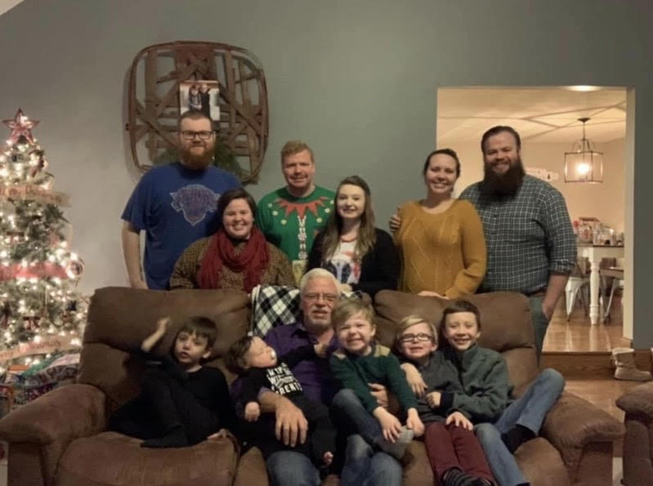

Slide 4
The What?
SPDAT (Service Prioritization Decision Assistance Prescreen Tool)
The SPDAT is an evidence-informed approach to assessing an individual’s/family’s acuity. The tool, across multiple components, prioritizes who to serve next and why, while also identifying the areas in the person/family’s life where support is most likely necessary in order to avoid housing instability.
VI (Vulnerability Index)
The VI-SPDAT helps identify who should be recommended for each housing and support intervention, moving the discussion from simply who is eligible for a service intervention to who is eligible AND in greatest need of that intervention. While the SPDAT is an assessment tool, the VI-SPDAT is a survey that anyone could complete, to help prioritize clients.

Slide 5
What does all that mean?
An assessment to help understand the needs of an individual or family and placing them on a prioritization list for housing
Prioritization
Not “last place”
Like an emergency room—helping those who need it the most
This tool will assess where their need is

Slide 6
The Assessment
Single (25 or older with no children in household)
http://pehgc.org/wp-content/uploads/2016/09/VI-SPDAT-v2.01-Single-US-Fillable.pdf
Family (single adult with children in the household)
https://www.havenforhope.org/wp-content/uploads/2018/11/VI-SPDAT-v2.01-Family-US-Fillable.pdf
Youth (18-24)
https://d3n8a8pro7vhmx.cloudfront.net/beehivegroupcadev/pages/1208/attachments/original/1479851613/Y-SPDAT-v1.0-Youth-Fillable.pdf?1479851613

Slide 7
Opening Script
No matter which type, you need to start with an introductory script that consists of the following:
Purpose of the VI-SPDAT (Coordinated Entry)
That it is short and should take ~15 mins
Only needing “yes” or “no” answers
Any question can be skipped, or stop the assessment at any time
Where the info is going to be stored (KYHMIS)/Release form
The importance of being honest
If they don’t understand a question, more information can be given

Slide 8
Get Familiar With The questions
Read over the assessment before completing one with a client, as you would not want to feel uncomfortable—it can make the client uncomfortable
The assessment can feel invasive, make sure you prep that as well
You are not the enemy or trying to “get things out of them”
Ex: I had someone say, “you’re trying to trick me”
Practice with staff at your service site

Slide 9
Get Familiar With The questions
Re-word the questions for context:
For time references:
Past 3 years you can say, “since 2017”
In the last 6 months, “since February”
Or even count backwards (August, July, June, etc.) to give context

Slide 10
Get Familiar With The questions
Have you been attacked or beaten up since you’ve become homeless?
Do you ever do things that may be considered risky, like exchange sex for money, run drugs for someone, have unprotected sex with someone you don’t know, share a needle, or anything like that?
Are you currently able to take care of your basic needs like bathing, changing clothes, using a restroom, getting food and clean water and other things like that?
Are there any medication that you a doctor said you should be taking that, for whatever reason, you are not taking?

Slide 11
You are the assessor
You will be asking and writing down the answers
As the assessor, you will want to stay on script as much as possible, but if you need to give more context, or believe the client needs more context, you can go off script
I try to maximize eye contact with the script, minimize eye contact with the assessment
Moving onto the next question quickly after answered, giving no judgement

Slide 12
Follow up Questions
These are helpful if you will not see them regularly
Where is the easiest place to find you, during what time?
Can I take your picture?
Email/phone number?

Slide 13
Need addition training?
Visit orgcode.com
Single Adult Training:
https://vimeo.com/126548635
Family Training:
https://vimeo.com/126591317

Slide 14
Questions?

Slide 15
THANK YOU!

