Slide 1
VISTA Project Sustainability

Slide 2
AmeriCorps VISTA Components
Ending poverty
Strengthening communities
Building capacity
Creating sustainable solutions

Slide 3
What is capacity building?
AmeriCorps capacity building activities to be indirect services that enable organizations to provide more, better and sustained direct services.

Slide 4
Types of Capacity Building
Activities that expand the:
Scale
Reach
Efficiency
Effectiveness
of programs and organizations
Activities intended to
Support or enhance the program delivery
Support goal of increasing, expanding service delivery
Provide a sustained level of more or better direct services

Slide 5
Capacity Building
Direct Service
vs.
Tasks & activities to expand the scale, reach, efficiency, or effectiveness of programs or organizations.
The act of providing services to the identified recipients or clients of a program.
Notes:
While VISTAs focus on capacity-building activities, they may, on occasion, perform limited direct service activities when deemed necessary to complete the VISTA’s overall capacity-building assignment. These incidental activities should be written into the VISTA Assignment Description (VAD) if known at the beginning of the VISTA’s term of service.
Sample VISTA activities
Research and apply for new funding sources, including grants
Recruit and train long-term community volunteers
Establish and cultivate new partnerships with donors, media, and community stakeholders
Design and implement databases to track donors and volunteers
Create templates for outreach and event planning Three E’s of direct service regarding VISTAs: Is it for Education? Is it an Emergency? Is Everyone doing it?
Many more
V ISTAS MAY experience MINIMAL direct service if it relates to accomplishing objectives in the VAD. Example: RedBud Financial Alternatives – VISTA is talking to clients, learning their needs and challenges, in order to better develop the programs and procedures that will be implemented.

Slide 6
Why does VISTA involve communities?
Community empowerment aims to increase the influence and control a community has over their lives as well as programs and structures that impact their lives.
Each project must be responsive and relevant to the lives of community residents and must tap into inherent community assets, strengths, and resources

Slide 7
What is Sustainability?
Ability of an organization to continue to be responsive to the needs of the community and effectively engage community stakeholders

Slide 9
VISTA Role in Sustainability
Supervisor/Project Site
VISTA Member
Envision future of the project
Create and implement a sustainability plan
Orient members to plan
Build capacity through VAD activities
Engage staff and community in VAD activities
Transfer knowledge, products, and relationships at end of service
Notes:
AmeriCorps VISTA members serve as short-term resources to build the long-term sustainability of antipoverty efforts. VISTA projects make a lasting difference through the commitment, energy, and initiative that VISTA members bring to the community; involvement of the sponsoring agency in supervising the project, supporting the VISTA members, and assessing the progress of the project toward meeting its goals; participation of the project beneficiaries in all phases of project development and implementation; and the continued involvement of community members by providing needed resources such as volunteers, material and financial resources, and expertise. Sponsors must develop projects with a goal to phase out the need for VISTAs and have the project continue without VISTA resources.

Slide 10
Promoting Sustainability
Add a sustainability lens to VAD activities
Will I or someone else have to do this again?
What circumstances could change?
Could others get involved?
What happens when I’m not here anymore?
Will this activity or process stop once my position is done?
Thinking with the End in Mind

Slide 11
Mindset for Sustainability
1. Sustainability is a journey, not a destination
2. Make plan logical, simply, easy to follow

Slide 12
Transferring for Sustainability
Knowledge
Products
Relationships

Slide 13
Tips for Transferring
Guidelines
Figure out the best tools, templates, resources, or training materials
Design with end in mind
Make them accessible
Labeling and clearly documenting
Make it easy to read
Activities
Train and coach users
Make guides
Contact database
Connecting people
Develop templates
Asset maps
Presentations to staff, volunteers, stakeholders

Slide 14
Examples
VISTA Leader, Nadiyah
Developed online trainings and tools to support diversity, equity and inclusion
Training materials and guides
Community contact spreadsheets
VISTA Member, Jordan
Built database of potential funders
Included document about requirements of grants and communication modes
Created online storage account to house the products they created

Slide 15
Sustainability Binders

Slide 16
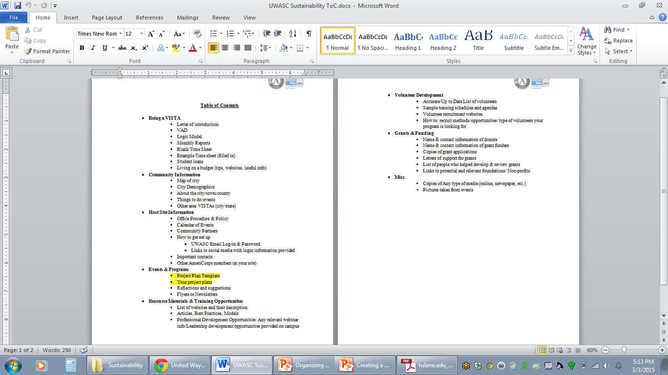
Example:

Slide 17
Suggestion: Use Bullets Instead Of Block Text
Block text is:
Intimidating
Less likely to be read
Hard to remember

Slide 18
Suggestion: Stick With One Font
You want your binder to be easy to follow
It should be as consistent as possible
Constant font changes are distracting
…And annoying
No Comic Sans
Easy to Read Fonts:
Times New Roman
Calibri
Palatino
Georgia
Courier
TW Cen MT
Garamond
Notes:
Serif fonts have little feet and embellishments on the tip and base of each letter, making them more distinct and recognizable.
Serif fonts are for "readability“
http://www.awaionline.com/2011/10/the-best-fonts-to-use-in-print-online-and-email/

Slide 19
Suggestion: Don’t Write a Journal
Sustainability binders are meant to be manuals
Neat, concise, well-organized
Limit handwriting where you can

Slide 20
Method: Use Chronological Order
Organizing your binder in order of major projects
Include a calendar with dates clearly marked
Great for sites with a lot of signature events
Pros:
Very logical
Easy to follow
Cons:
Not all content easily fits (continuous projects)

Slide 21
Method: Questions
Organize by what questions are answered
When people need help, they are looking for answers
Direct them where to go
Pros:
Imitates how we actually look for information
Very flexible
More traditional
Cons:
Not as logical
Tedious: How do you know what to include?

Slide 22
Tips
Documentation
Document EVERYTHING!
Use narratives—tell a story
It’s better to have more information than not enough
Identification:
All of your documents should be easily identified
Create a file-naming protocol (e.g. Document Title_YearMonthDay 🡪 Example_20150303)
File Paths: Your documents should be easy to find| Try listing the file path and location on every document
Consistency:
Once you choose a system, stick with it
Files and documents should be uniform

Slide 23
Other Tips
Introduction
The next VISTA may not be a telepathic mind reader
Introduce your system and strategy
Don’t forget
Keep a running task list so you don’t forget to add things
Update your binder as things happen
Keep an idea journal; organize and add to binder
Proof Read
Ask several people not already family with your work to read through your binder
What questions do they have?
Leave more than one copy
Notes:
Utilize the resources available to you
Talk to your supervisor
Use your VAD
Talk to other VISTAs
VISTA Campus
Facebook

